Slide 1
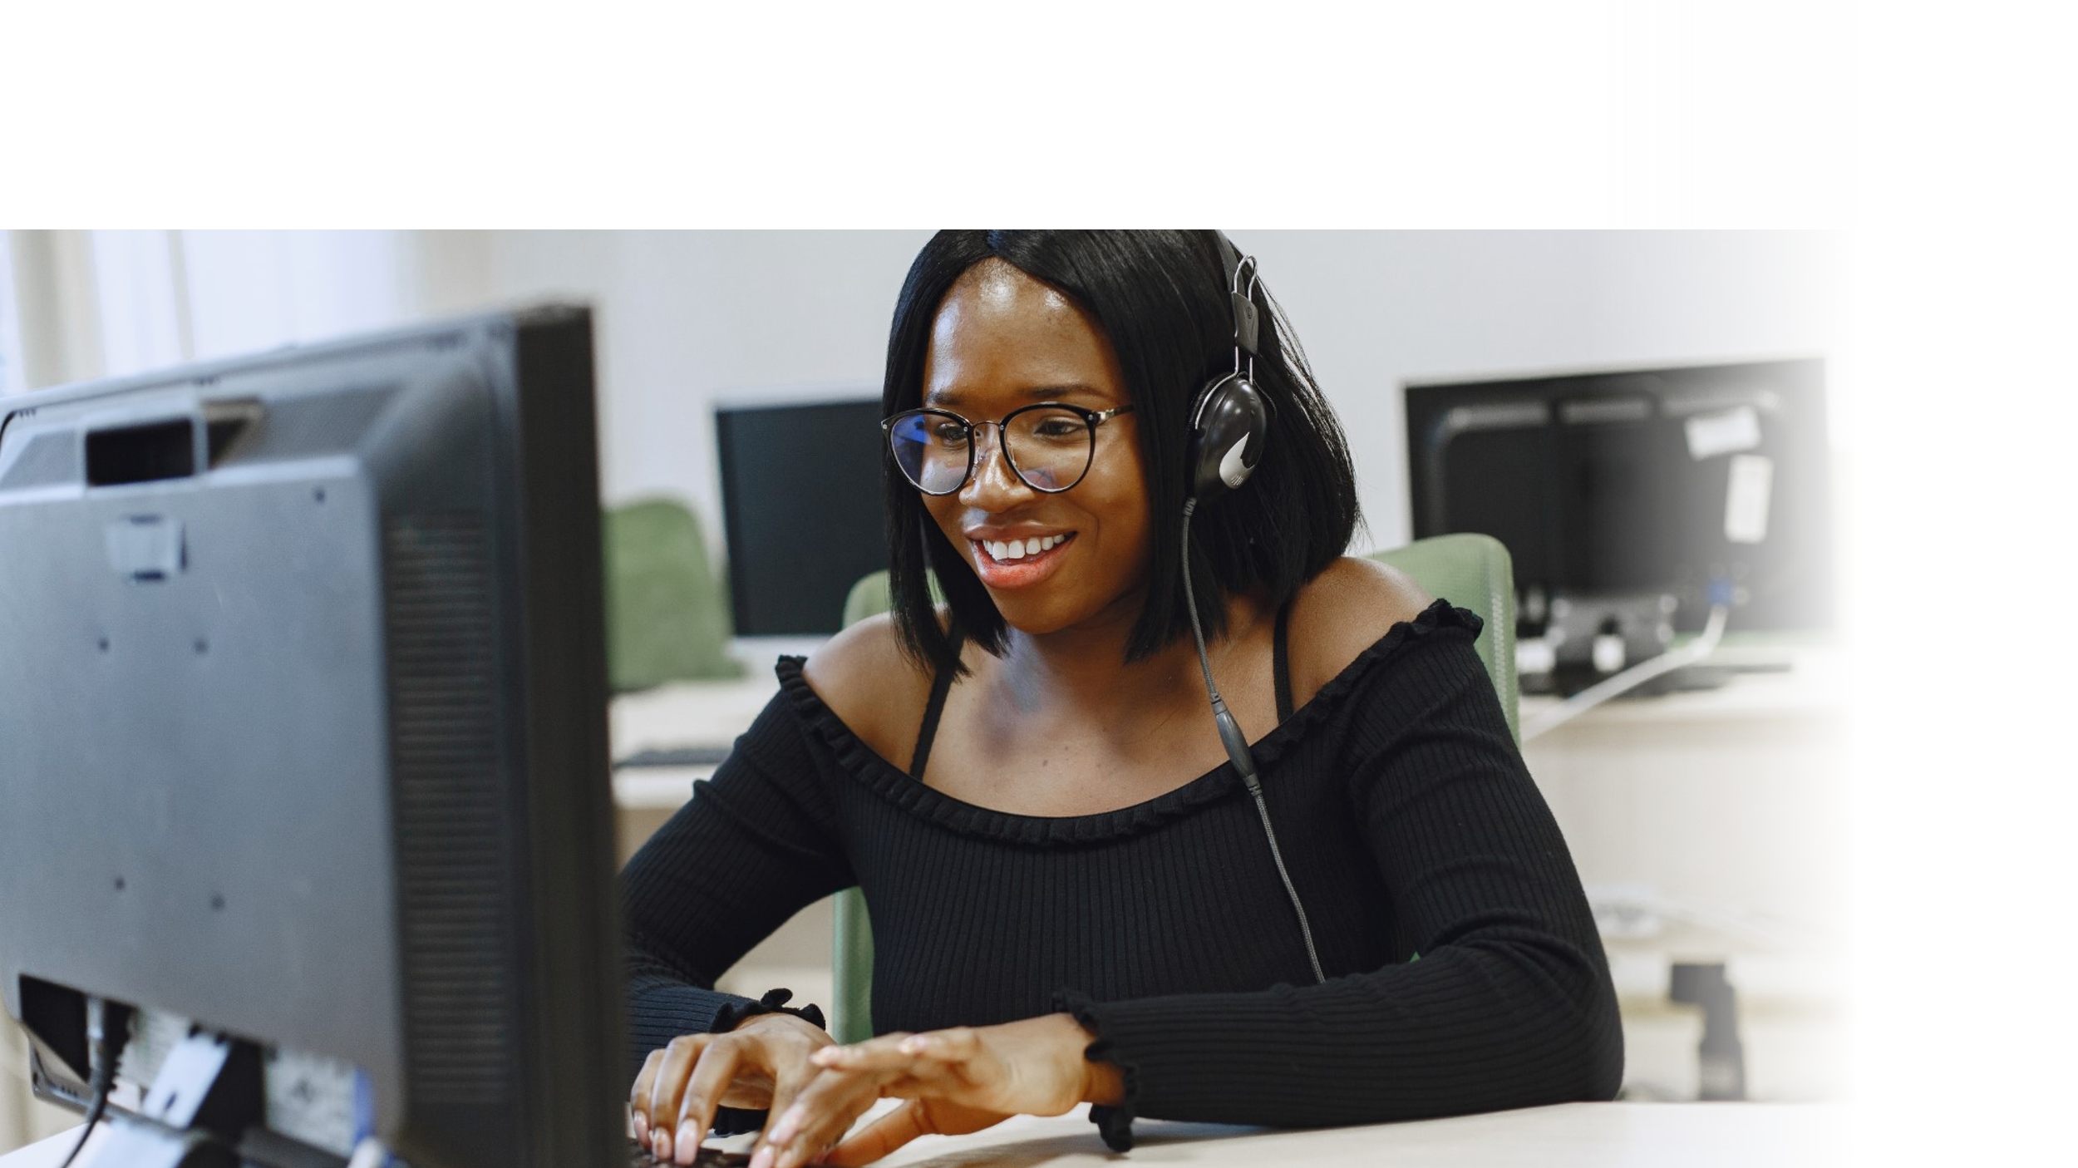



DIGITAL LITERACY
SKILLS
INTERMEDIATE USERS

Slide 2
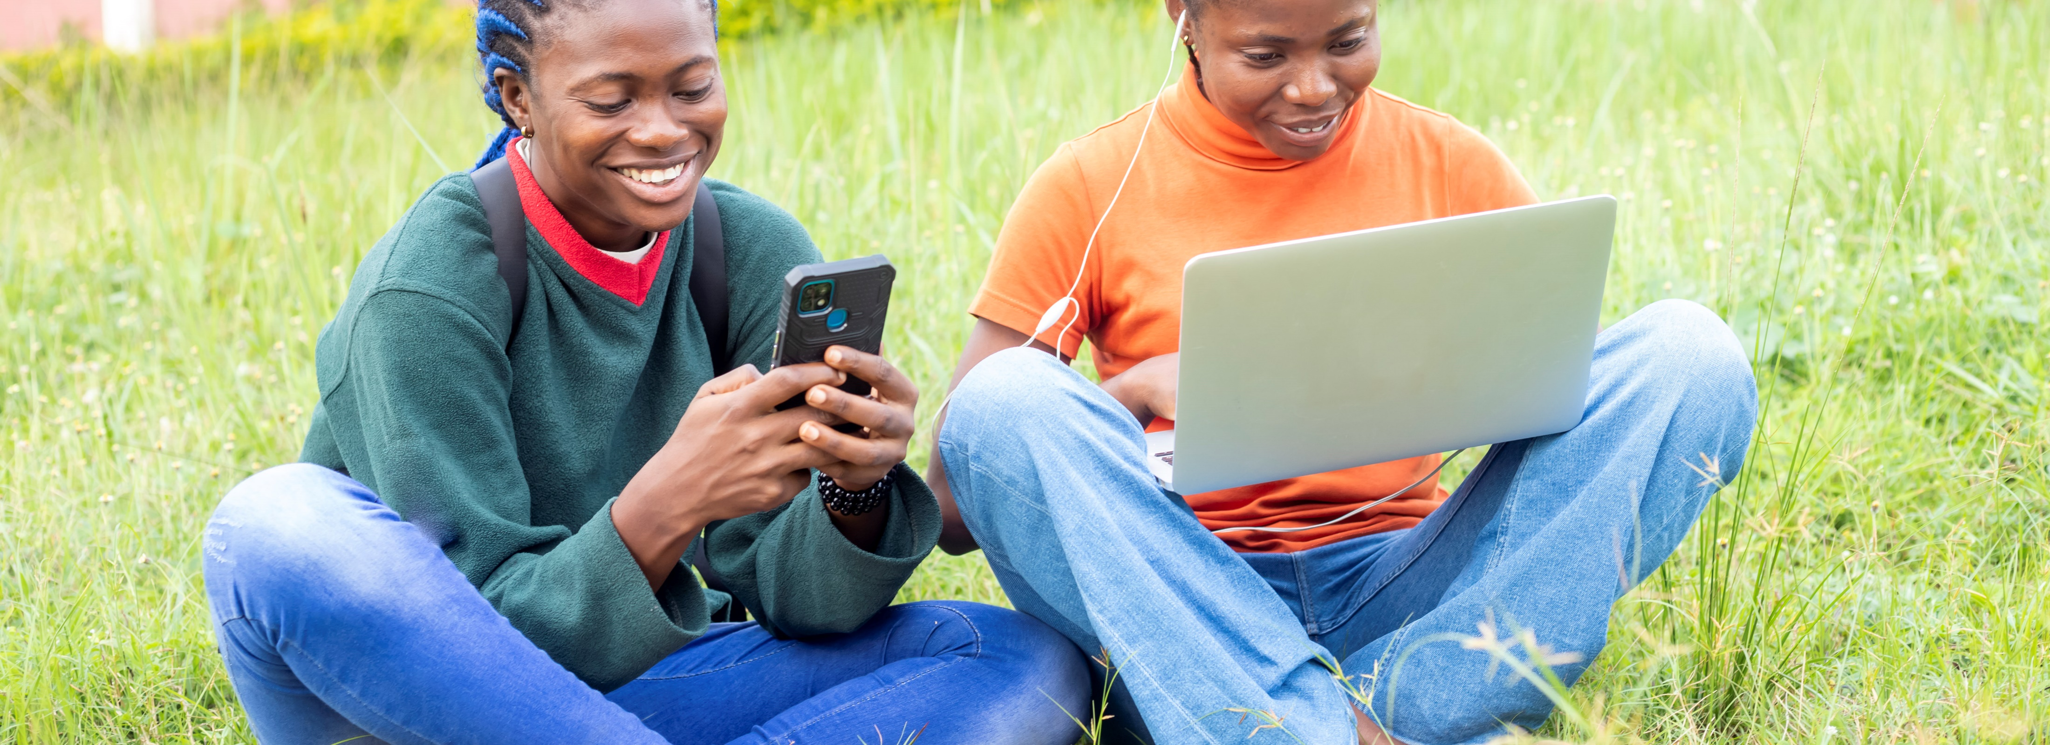
Module 5
Safety and security

Slide 3

2
Unit 2: Protecting personal data and privacy

Slide 4
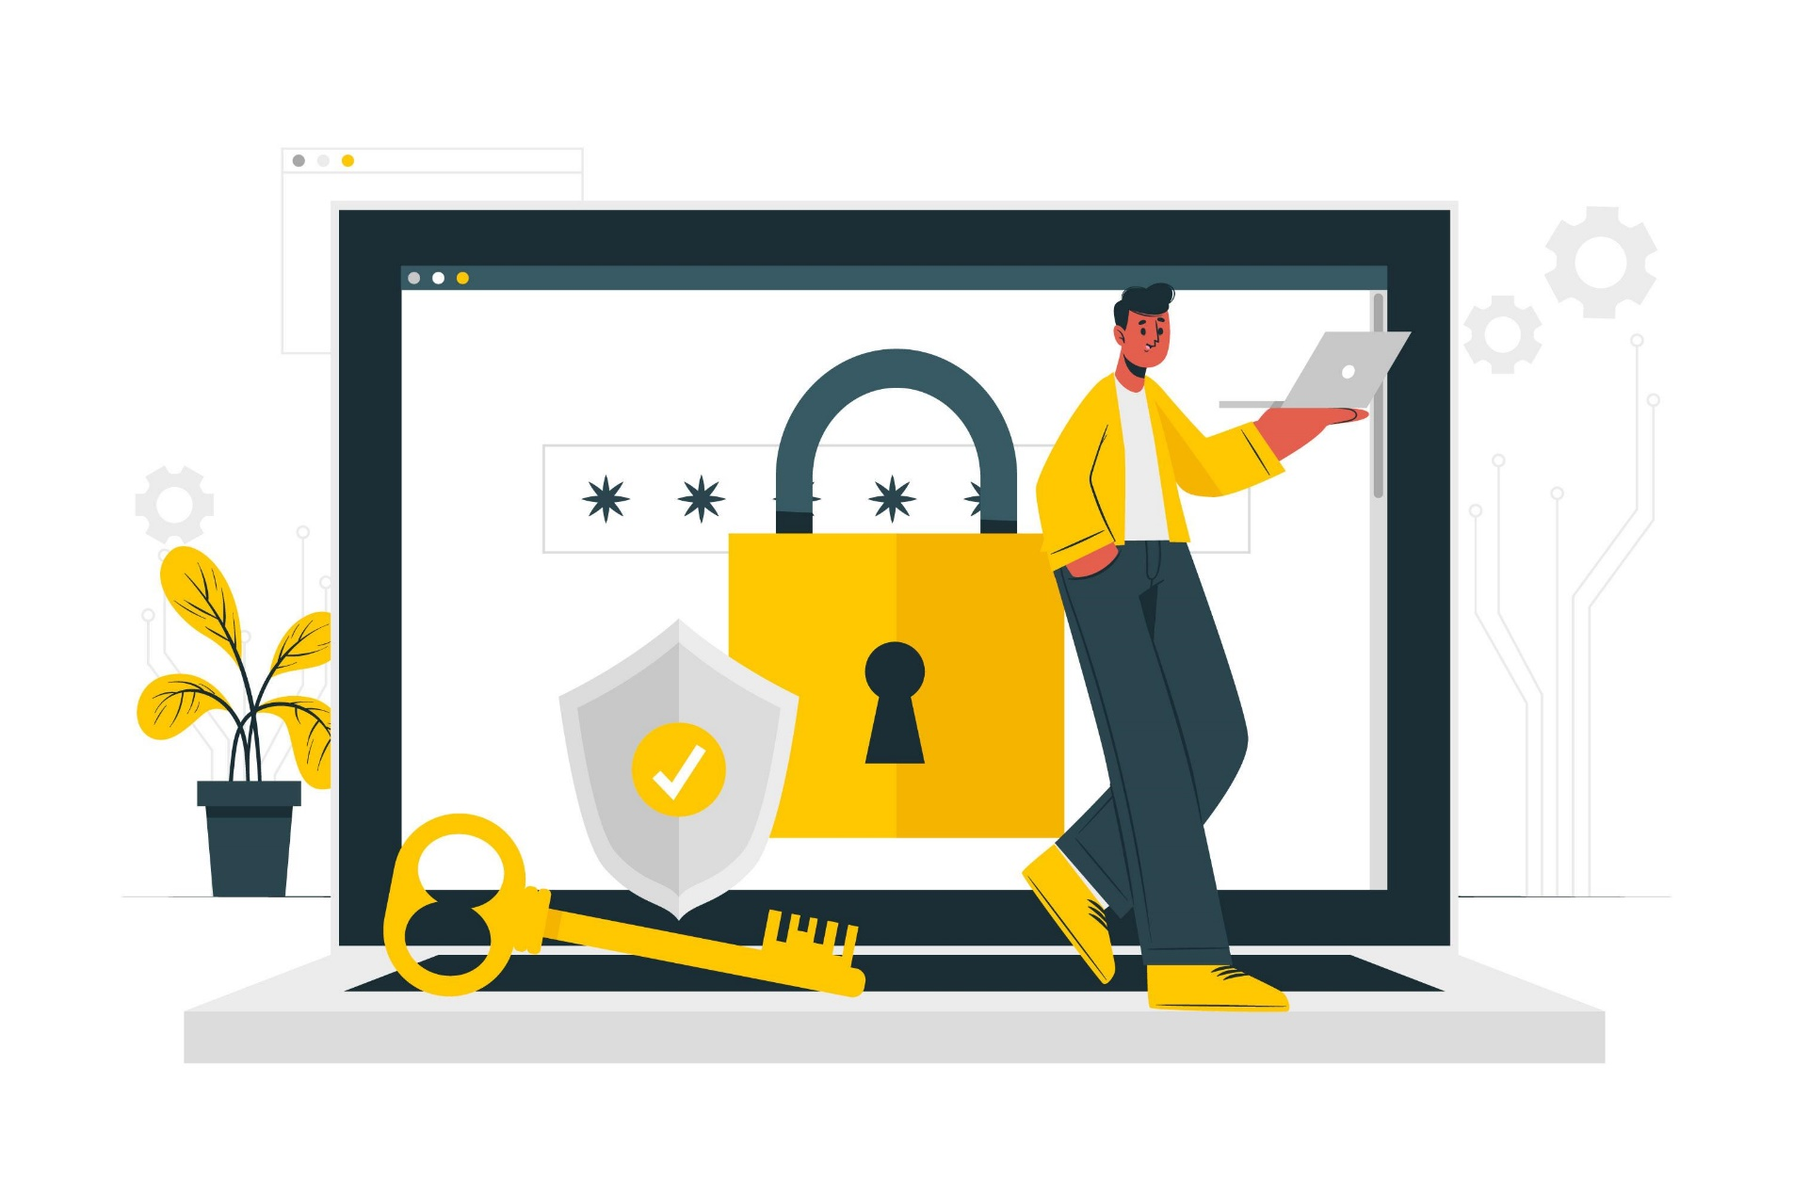
Protecting yourself online
How can you protect yourself?
Limit the amount of personal information you share.
Remember that the internet is a public resource.
Be wary of strangers.
Be sceptical.
Evaluate your settings.
Be wary of third-party applications.
Check privacy policies.

Slide 5
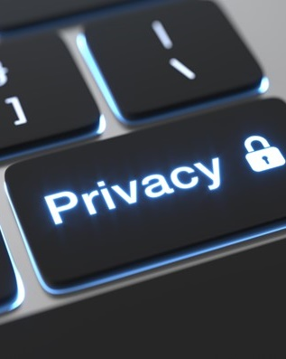
Guidelines for sharing personal information
View the internet as a novel, not a diary.
Limit the amount of personal information you post.
Realize that you cannot take it back.
You are not anonymous.

Slide 6
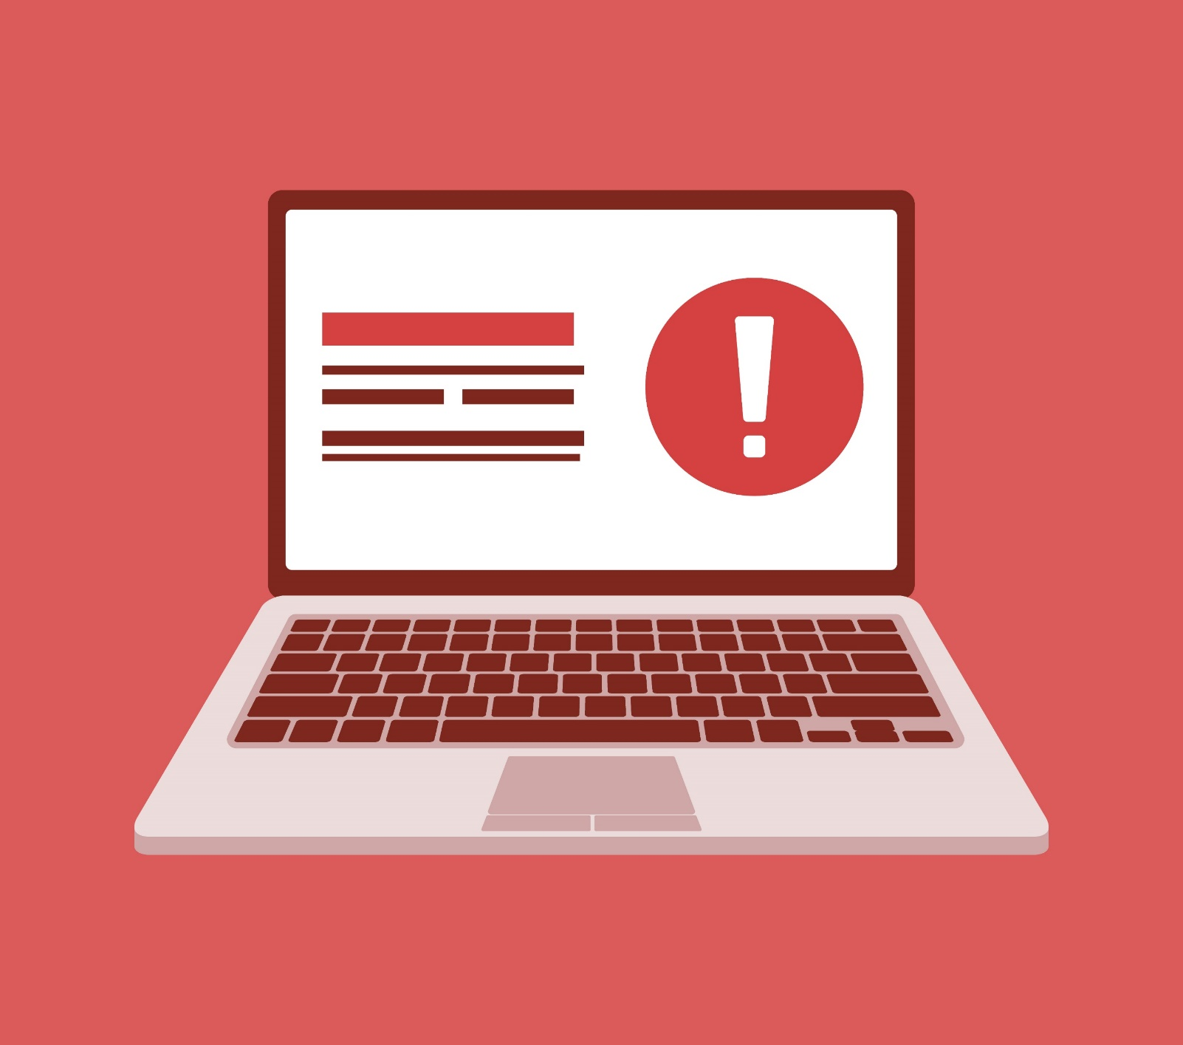
Reduce email threats
Phishing emails are the most common attack routes.
A phishing email is is sent to you pretending to be for a certain purpose, to get a response from you.
It relies on you making a mistake and answering the email or clicking on a link in the email.
There are many indicators that can help you to identify a phishing email.
Banks will never send an email with a link to update something on your account.
Check for spelling mistakes or strange addresses.
Do not click on links from emails.

Slide 7
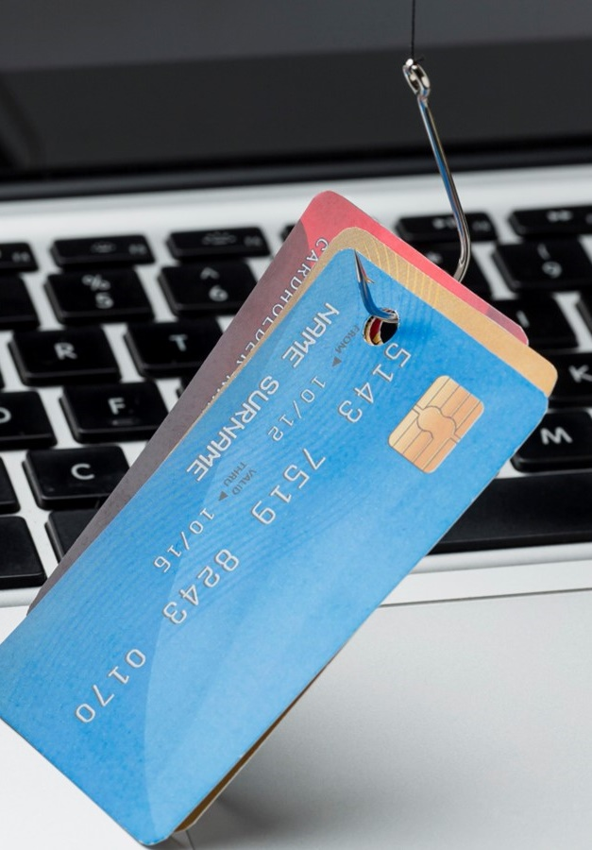
Avoiding social engineering and phishing attacks
Social engineering attacks
Phishing attacks
Vishing attacks
Smishing attacks

Slide 8
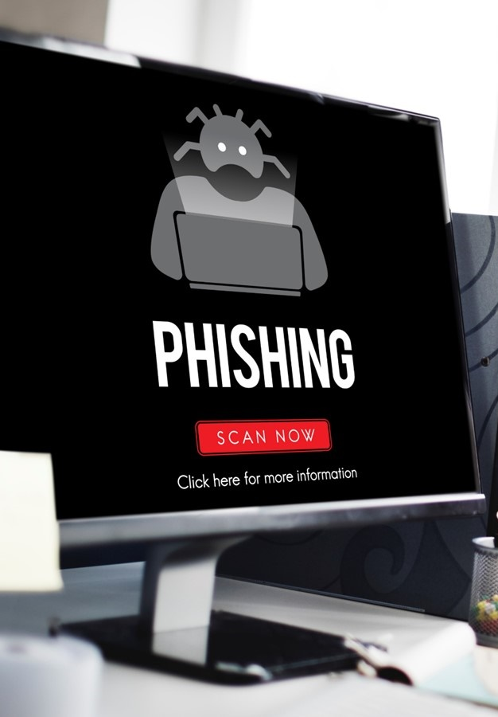
Common indicators of phishing attempts
Be aware of these indicators:
Suspicious sender’s email address
Generic greetings and signatures
Spoofed hyperlinks and websites
Spelling and layout
Suspicious attachments

Slide 9
Skills to practise
Investigate data protection and privacy
Complete an internet search to find out the type of privacy settings that are necessary for a laptop, tablet, and smartphone.
Extend your search to find out how to change the privacy settings of a laptop, tablet, and smart phone.
Look at and take note of the privacy setting on the device you are using. If it is in the computer centre at your school of community centre, only the network administrator will have access to change the settings.
If you feel that the privacy of the device has been compromised, notify your facilitator.
Ask the facilitator to help you change your password if you do not have access to do this yourself.

Slide 10
All back covers should include
contact information of the section
producing the work.
© United Nations Children’s Fund (UNICEF) [month and year of publication]

